Slide 1
SOA服务框架 - RpcLite 介绍及原理
Chris Huang
chrishwang@live.cn 2015-8-25

Slide 2
目录
组件架构
基本原理
Service端主要类
Client端主要类
Service配置
Client配置
Demo
FAQ

Slide 3
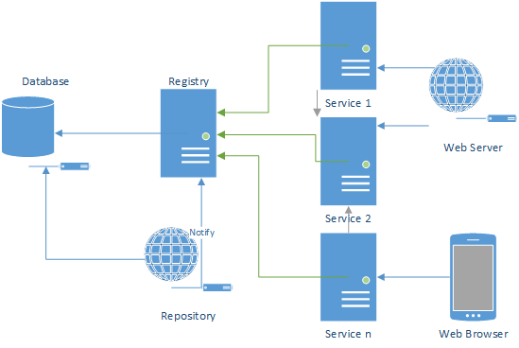
组件架构

Slide 4
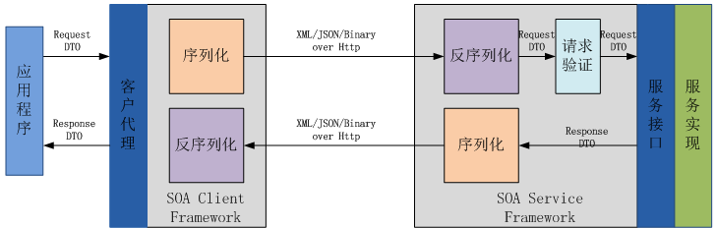
基本原理

Slide 5
Service端主要类

Slide 6
Client端主要类

Slide 7
Service配置
<?xml version="1.0"?>
<configuration>
<configSections>
<section name="RpcLite" type="RpcLite.Config.RpcLiteConfigSection, RpcLite"/>
</configSections>
<RpcLite>
<appId>10000</appId>
<services>
<add name="ProductService" path="~/api/async-product/" type="ServiceImpl.ProductAsyncService,ServiceImpl"/>
</services>
</RpcLite>
<system.webServer>
<handlers>
<add name="1" path="api/*" verb="*" type="RpcLite.Service.RpcAsyncHandler, RpcLite, Version=1.0.0.0, Culture=neutral"/>
<add name="2" path="api/*/*" verb="*" type="RpcLite.Service.RpcAsyncHandler, RpcLite, Version=1.0.0.0, Culture=neutral"/>
<add name="3" path="api/*/*/*" verb="*" type="RpcLite.Service.RpcAsyncHandler, RpcLite, Version=1.0.0.0, Culture=neutral"/>
<add name="4" path="api/products/*" verb="*" type="RpcLite.Service.RpcAsyncHandler, RpcLite, Version=1.0.0.0, Culture=neutral"/>
</handlers>
<httpProtocol>
<customHeaders>
<add name="Access-Control-Allow-Methods" value="OPTIONS,POST,GET"/>
<add name="Access-Control-Allow-Headers" value="x-requested-with,content-type"/>
<add name="Access-Control-Allow-Origin" value="*"/>
</customHeaders>
</httpProtocol>
</system.webServer>
</configuration>

Slide 8
Client配置
<?xml version="1.0" encoding="utf-8"?>
<configuration>
<configSections>
<section name="RpcLite" type="RpcLite.Config.RpcLiteConfigSection, RpcLite" />
</configSections>
<RpcLite>
<appId>10000</appId>
<environment>it</environment>
<addressResolver name="default" type="RpcLite.Resolvers.HttpClientAddressResolver, RpcLite.Resolvers" />
<clients environment="it">
<add name="ProductService" type="Contracts.IProduct,Contracts" namespace="v1" />
<add name="RegisteryService" type="ServiceRegistery.Contract.IRegistryService,ServiceRegistery.Common" namespace="v1" path="http://localhost:2212/api/service/" />
</clients>
</RpcLite>
</configuration>

Slide 9
Thanks

